Slide 1

Java Packages

Slide 2
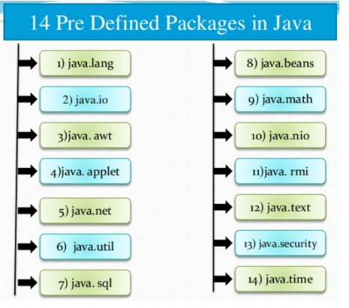
Java Packages
A java package is a group of similar types of classes, interfaces and sub-packages.
Types of packages :
  built-in package – System defined packages
  user-defined package
Examples of built-in packages :
  java.lang
  java.util
  java.io
  java.applet
  java. awt
  Java.awt.event

Slide 3
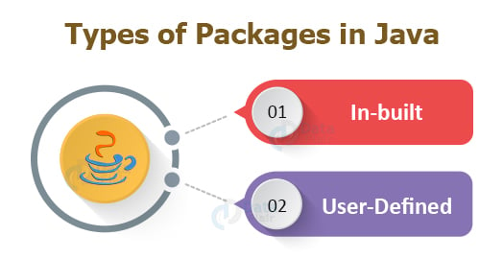

Slide 4
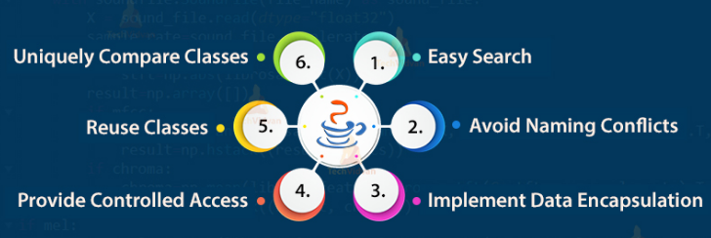
Advantage of Java Package

Slide 5
Static Import
The static import facilitate the Java programmer to access any static member of a class directly.
Advantage of static import
  Less coding is required if you have access any static member of a class often.
Example:
  import static java.lang.System.*;
  class Static_Ex
  {
  public static void main(String args[ ])
  {
  out.println("Hello");//Now no need of System.out
  out.println("Java");
  }
  }

Slide 6
java.lang
java.lang is automatically imported into all programs
java.lang includes the following classes:
Boolean | Long | ThreadLocal
Byte | Math | StrictMath
Character | Number | String
Class | Object | StringBuffer
ClassLoader | Package | System
Compiler | Process | Thread
Double | Runtime | ThreadGroup
InheritableThreadLocal | RuntimePermission | StackTraceElement
Float | SecurityManager | Throwable
Integer | Short | Void

Slide 7
String
String is a sequence of characters.
In java, objects of String are immutable which means a constant and cannot be changed once created.
Non - Primitive data types
System defined class
Ex. "AAA","A123","234","Java“
Ways to create string :
  String Literals
  String = “Atmiya”;
  Using new keyword
    String s = new String(“Atmiya”);
Constructors:
String( ) :
  Constructs a new empty String.
  Ex. String ct=new String()
String(String):
  Constructs a new String that is a copy of the specified String.
    Ex. String ct=new String(“Rajkot”)

Slide 8
Constructors…
String(char[ ]) :
  Constructs a new String whose initial value is the specified array of characters.
Ex. char[ ] c={‘r’, ’a’, ’j’, ’k’, ’o’, ‘t’};
String ct=new String( c);
String(char[ ], int, int) :
  Constructs a new String whose initial value is the specified sub array of characters.
Ex. char[] c={‘r’, ’a’, ’j’, ’k’, ’o’, ‘t’};
String ct=new String( c,0,2); //raj

Slide 9
Constructors…
String(byte[]) :
  Constructs a new String whose initial value is the specified array of bytes.
Ex. byte[] b={65,66,67,68,69};
      String str=new String( b); //ABCDE
String(byte[], int, int) :
  Constructs a new String whose initial value is the specified sub array of bytes.
Ex. byte[] b={65,66,67,68,69};
      String str=new String( b,2,3); //CD

Slide 10
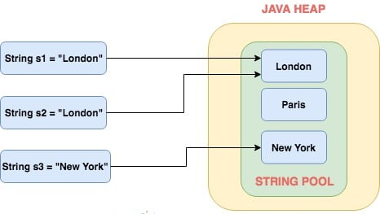
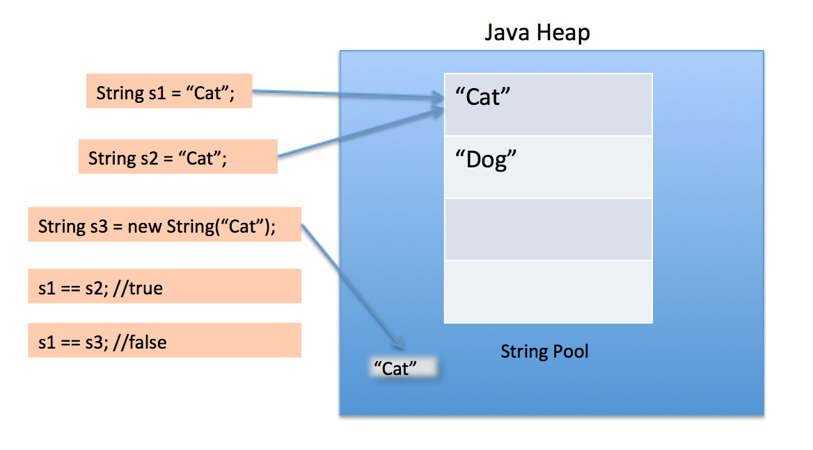

Slide 11
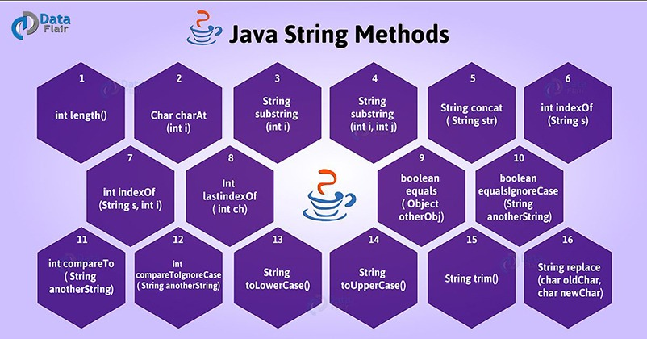
Methods of String class

Slide 12
String Methods…
int length( ) :
  Returns the length of this string
  Ex. String str=“Rajkot”
  int i=str.length( ) //6
String concat(String):
  Concatenates the specified string to the end of this String.
  Returns the concatenated String.
      Ex. String str=“Rajkot”
      str.concat(“ Gujarat”) //Rajkot Gujarat
char charAt(int) :
  Returns the character at the specified index.
  e.g. String str=new String(“atmiya”)
      char c= str.charAt(3); // i

Slide 13
Methods…
int compareTo(String):
  Compares this String to another specified String if match then return zero(0) otherwise not zero(0).
    Ex. String str = new String(“atmiya”);
    int ans = str.compareTo(“atmiya”) //0
int compareToIgnoreCase(String):
  Compares two strings , ignoring case differences.
    Ex. String str=new String(“Atmiya”)
    int ans = str.compareToIgnoreCase(“atmiya”) //0
byte[] getBytes( ) :
  Copies characters from this String into the specified byte array.
  Ex. byte b[]=new byte[10];
    String s=“Rajkot”
    b = s.getBytes( );

Slide 14
Methods…
char[] toCharArray() :
  Converts this String to a character array.
String s = “Atmiya”;
  char c[]=new char[10];
    c = s.toCharArray( );
String toUpperCase() :
  Converts all of the characters in this String to upper case.
  String s1,s2;
  s1=“atmiya”;
  s2=s1.toUpperCase( ) //ATMIYA
String toLowerCase( ) :
  Converts all of the characters in this String to lower case using.
String s1,s2;
s1=“ATMIYA”;
s2=s1.toLowerCase() //atmiya

Slide 15
Methods…
String substring(int, int) :
  Returns the substring of a String.
    String s1,s2;
    s1=“ATMIYA”;
    s2=s1.substring(3,5) //IY
String replace(char, char) :
  Converts this String by replacing all occurrences of oldChar with newChar.
    String s1,s2;
    s1=“atmiya”;
    s2=s1.replace(‘a’,’A’) //AtmiyA

Slide 16
Methods…
int indexOf(String) :
  Returns the index within this String of the first occurrence of the specified substring.
int indexOf(String, int) :
  Returns the index within this String of the first occurrence of the specified substring.
Ex. String s1=“atmiya”
int index=s1.indexOf(“a”);// 0
int index=s1.indexOf(“a”,2);// 5
String[] split(String regex,int limit) :
  Splits the string
String str=“This is split function demo”;
String s1[]=str.split(“ “,0); //s1[0]=This, s1[1]=is

Slide 17
Methods
boolean contains(String) :
  Checks whether a string contains a sequence of characters
  Ex. String str1 = “Java is simple language.”;
  boolean b = str1.contains(“is”); // returns true
boolean equals( String) :
  checks whether two strings are equals or not.
  Ex. String str1 = “Hello”;
  String str2 = “hello”;
  str1.equals(str2) // returns false

Slide 18
String comparison
boolean equalsIgnoreCase(String) :
  Ignore the case
  Ex. String str1 = “Hello”;
  String str2 = “hello”;
  str1.equalsIgnoreCase(str2) // returns true
boolean startsWith( String sub) :
  check whether string begin with specified sub string or not.
  Ex. String s = “Atmiya”;
  s.startsWith(“At”); // returns true
boolean endsWith(String sub) :
  check whether string end with specified sub string or not.
  Ex. String s = “Atmiya”;
  s.endsWith(“ya”); // returns true

Slide 19
StringBuffer class
Peer class of String class
String represents fixed length and immutable character sequence.
StringBuffer allows growable and writable character sequence.
Characters in StringBuffer can be inserted / appended / added /deleted any where and the size of the StringBuffer will automatically grow/shrink.
  StringBuffer str=new StringBuffer(“VSC”);

Slide 20
StringBuffer Constructors
StringBuffer( ) :
  Reserves room for 16 characters
StringBuffer(int size):
  Explicitly sets the size of buffer
StringBuffer(String str):
  Sets the initial content of the string Buffer and allocates room for 16 more characters
When no specific length is specified, StringBuffer allocates space for 16 more characters

Slide 21
Methods
Method | Description
StringBuffer append(String s) | is used to append the specified string with this string.
StringBuffer insert(int index, String s) | is used to insert the specified string with this string at the specified position.
StringBuffer replace(int startIndex, int endIndex, String str) | is used to replace the string from specified startIndex and endIndex.
StringBuffer delete(int startIndex, int endIndex) | is used to delete the string from specified startIndex and endIndex.
StringBuffer reverse( ) | is used to reverse the string.

Slide 22
Methods…
Method | Description
int capacity( ) | return the current capacity.
char charAt(int index) | return the character at the specified position.
int length( ) | return the length of the string
String substring(int beginIndex) | return the substring from the specified beginIndex.
String substring(int beginIndex, int endIndex) | return the substring from the specified begin and end Index.
int indexOf(String str) | returns the index within this string of the first occurrence of the specified substring.
void setCharAt(int index, char ch) | replace the given character at given place

Slide 23
Example
class A
{
public static void main(String args[ ])
{
StringBuffer sb=new StringBuffer("Hello ");
sb.append("Java");//original string is changed
System.out.println(sb);//prints Hello Java
sb.reverse();
System.out.println(sb);//prints avaJ oellH
}
}

Slide 24
Object class
The Object class is the parent class of all the classes in Java by default.
It is the topmost class of Java.
All predefined classes and user defined classes are sub classed from Object class.
Belongs into java.lang package.

Slide 25
Methods…
public boolean equals(Object obj):-
  compares the given object to this object.
public String toString() :-
  returns the string representation of this object.
protected void finalize():-
  is invoked by the garbage collector before object is being garbage collected.

Slide 26
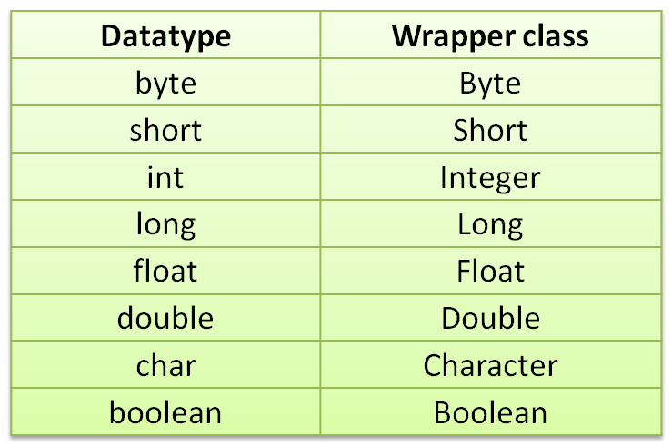
Wrapper Classes
The wrapper class in Java provides the mechanism to
convert primitive into object and object into primitive.
Wrapper classes provide a way to use primitive data types (int, boolean, etc..) as objects.
The automatic conversion of primitive into an object is known as autoboxing and vice-versa unboxing.

Slide 27
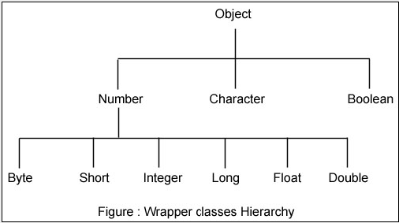
Hierarchy of wrapper classes

Slide 28
Convert Object num to primitive num
Method | Action
Integer val = new Interger(10); int i = val.intValue( ) | Integer object to int
Float val = new Float(10.5); Float f = val.floatValue( ) | Float object to float
Long val = new Long(100000); long l = val.longValue( ) | Long object to long
Double val = new Double(10); double d = val.doubleValue( ) | Double object to double

Slide 29
Converting numbers to String
Using toString( ) any Number object can converted into String object.
For Ex:
  Integer val = new Integer(10);
  String str = val.toString( ); //now str = “10”
Likewise you can convert any number object to String object.

Slide 30
Convert String object to numeric object
Using valueOf( ) method of number class we can convert string object to particular number object.
For Ex:
  String str = “1234”;
  Integer val = Integer.valueOf(str); // val = 1234
  String s1= String.valueOf('a'); // s1="a"
  String s2=String.valueOf(true); // s2="true"
Likewise you can convert string object to any number object.

Slide 31
Convert numeric string to primitive data types
Convert a String to any of the primitive data types, except character.
All these methods are static.
These methods have the format parse*() where * refers to any of the primitive data types except char.
For ex:
  String str = “34”;
  int x = Integer.parseInt(str); // x=34
  String str = “34.45”;
  double y = Double.parseDouble(str); // y =34.45

Slide 32
USER DEFINED PACKAGE

Slide 33
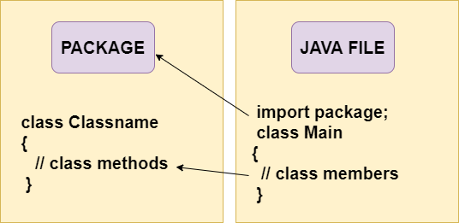
USER DEFINED PACKAGES

Slide 34
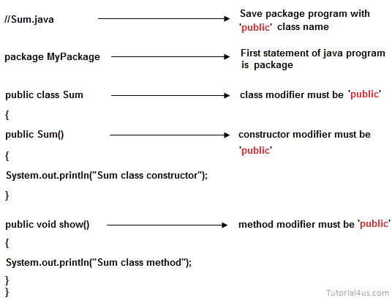
RULES TO CREATE USER DEFINED PACKAGE

Slide 35
Rules to create user defined package
Package statement should be the first statement of any package program.
Class name or interface name must be with modifier as public.
Any package program can contain only one public class or only one public interface but it can contain any number of normal classes.
Package program should not contain any main class (that means it should not contain any main())
modifier of constructor of the class which is present in the package must be public.
The modifier of method of class or interface which is present in the package must be public
Every package program should be save either with public class name or public Interface name

Slide 36
Points to be remembered
A package is always defined as a separate folder having the same name as the package name.
Store all the classes in that package folder.
All classes of the package which we wish to access outside the package must be declared public.
All classes within the package must have the package statement as its first line.
All classes of the package must be compiled before use.

Slide 37
How to access package from another package?
Three ways to access the package from outside the package.
  import package.*;
    All the classes and interfaces of this package will be accessible but not subpackages.
  import package.classname;
    Only declared class of this package will be accessible.
  fully qualified name
    Only declared class of this package will be accessible.
    No need to import.
    But you need to use fully qualified name every time when you are accessing the class or interface.

Slide 38
How to access package from another package?
For import the Scanner class from util package.
import java.util.Scanner;
For import all the classes from util package
import java.util.*;

Slide 39
Importing by using full qualified path name
//save by A.java
package pack;
public class A
{
public void msg(){System.out.println("Hello");}
}
//save by B.java
package mypack;
class B
{
public static void main(String args[]){
pack.A obj = new pack.A();//using fully qualified name
obj.msg();
}
}

Slide 40
Example for User Defined Package
The package keyword is used to create a package in java.
package mypack;
public class Simple_Pack
{
public static void main(String args[ ])
{
System.out.println("Welcome to package");
}
}
Compile: javac –d . Simple_Pack.java
( Here dot represents current directory )
Run : java mypack.Simple_Pack
Output:
Another Example:

Slide 41
Access package from another package
package pack;
public class A
{ public void msg()
{ System.out.println("Hello"); }
}
====================
package mypack;
import pack.*;
class B
{ public static void main(String args[ ])
{ A obj = new A( );
obj.msg();
}
}
Example A
Example B

Slide 42
Access Specifiers
Java Access Specifiers (Visibility Specifiers ) regulate access to classes, attributes and methods in Java.
It determine whether attributes or methods in a class, can be used or invoked by another method in another class or sub-class.
Access Specifiers can be used to restrict access.
Access Specifiers are part of object-oriented programming.
Types Of Access Specifiers :
1. public
2. private
3. protected
4. default(no specifier)

Slide 43
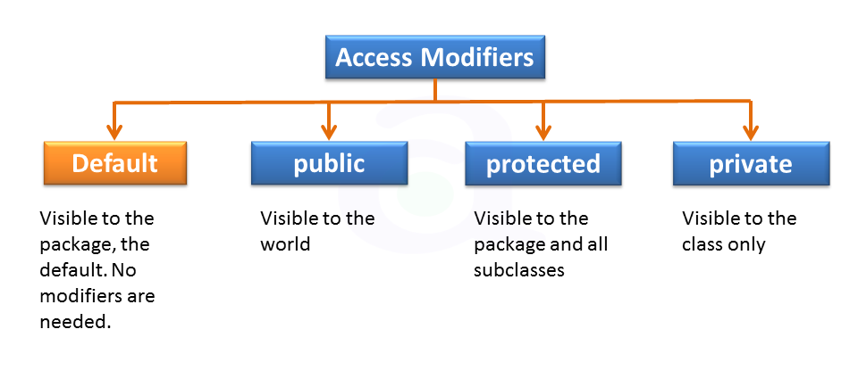
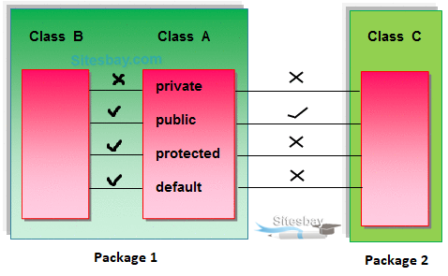
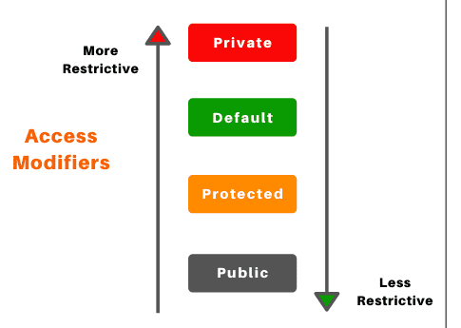

Slide 44
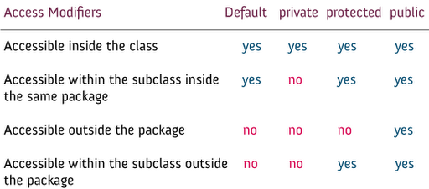
Access Specifiers…

